Slide 1
Introduction to Embedded System
Unit 1(continued)

Slide 2
Topics to be discussed
Embedded system architecture
Architectural Structures
System Model
Standards
Programming Languages and Standards
Standards and Networking
Multiple standards-based device

Slide 3
Embedded system architecture
Architecture-level information is physically represented in the form of structures.
An architecture is typically made up of more than one structure.
All structures are inherently related to each other.
Structure:
snapshot of the system’s hardware and software at design time and/or at run-time, given a particular environment and a given set of elements.
Next, a table is shown that:
Summarizes some of the most common structures that can make up embedded architectures
Shows generally what the elements of a particular structure represent and how these elements interrelate.

Slide 4
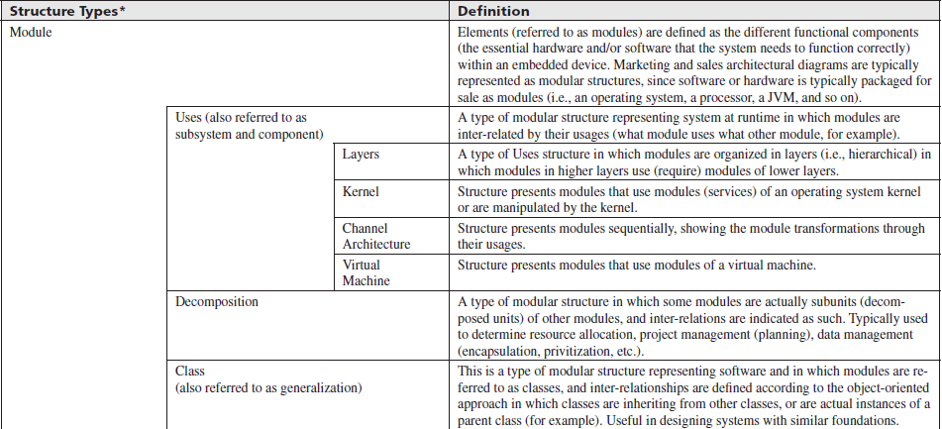
Architectural Structures

Slide 5
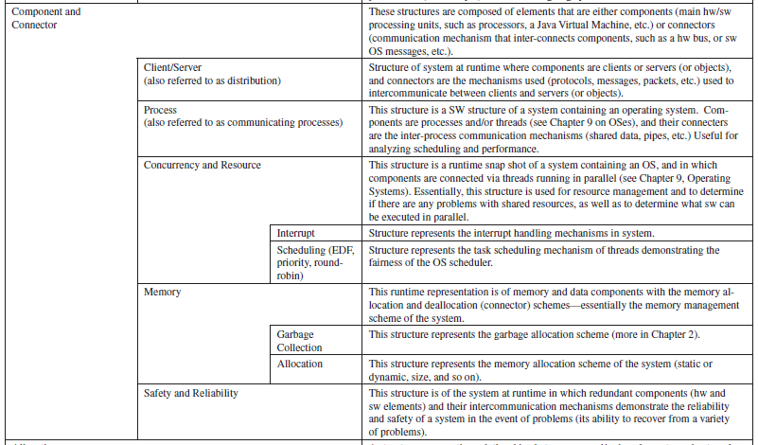
Architectural Structures(Cntd..)

Slide 6
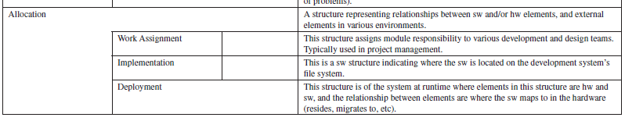
Architectural Structures(Cntd..)

Slide 7
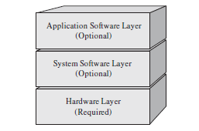
System Model
It’s a primary architectural tool, introduces the major elements located within an embedded system design.
All embedded systems share one similarity at the highest level; i.e. they all have at least one layer (hardware) or all layers into which all components fall.
hardware layer
contains all the major physical components located on an embedded board,
system & application software layers
contain all of the software located on and being processed by the embedded system.

Slide 8
Standards
Standards dictate
how components should be designed,
what additional components are required in the system to allow for their successful integration and function.
standards can define functionality that is specific to each of the layers of the embedded systems model,
Standard can be classified as:
market-specific standards(intended for specific groups of embedded devices),
general-purpose standards,
or standards that are applicable to both categories(include networking standards and some television standards.).

Slide 9
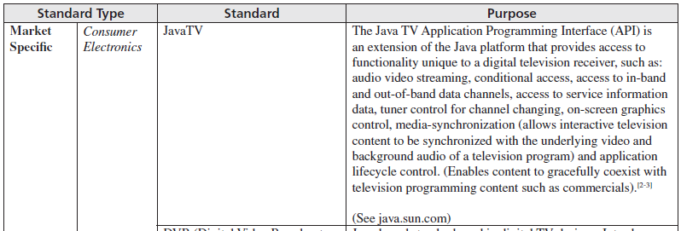
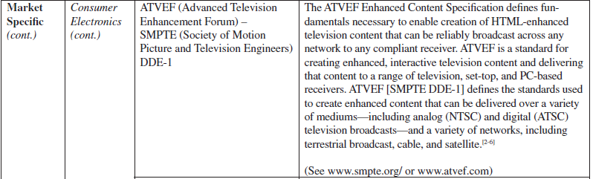
Examples of standards implemented in embedded systems

Slide 10
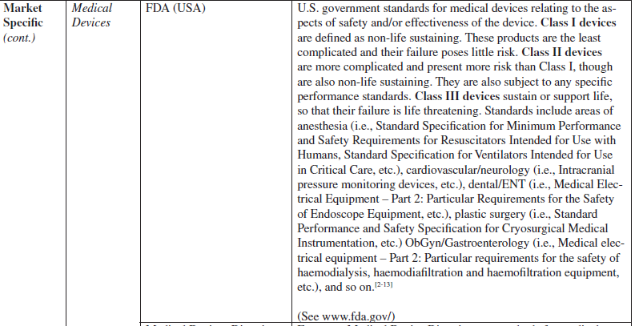
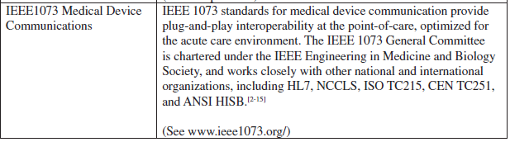
(Cntd.)

Slide 11
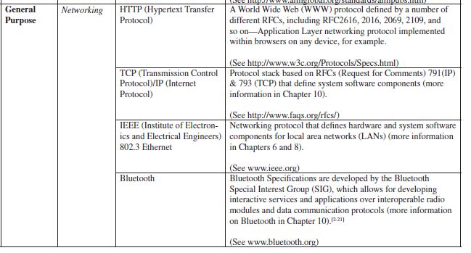
(Cntd.)

Slide 12
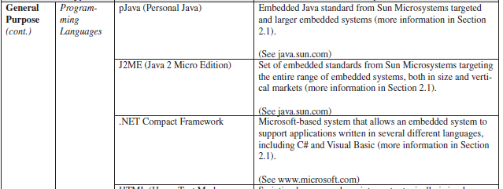
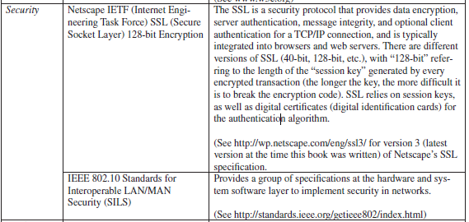
(Cntd.)

Slide 13
Programming Languages and Standards
A programming language can introduce an additional component into an embedded architecture
In embedded systems design, there is no single language that is the perfect solution for every system.
Examples- Java and the .NET Compact Framework, ANCI C
Because machine code is the only language the hardware can directly execute, all these languages need some type of mechanism to generate the corresponding machine code.
This mechanism usually includes one or some combination of preprocessing, translation, and interpretation.

Slide 14
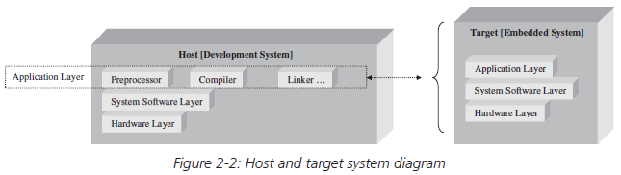
(Cntd...)
Depending on the language, these mechanisms exist on the programmer’s host system (typically a nonembedded development system, such as a PC or Sparc station), or the target system (the embedded system being developed).

Slide 15
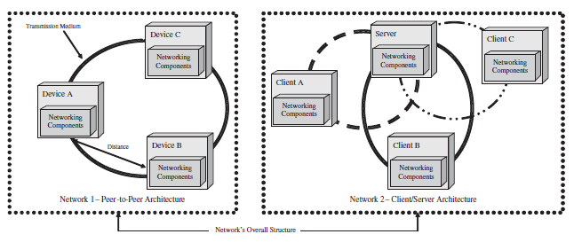
Standards & Networking
If an embedded system needs to communicate with any other system, whether a development host machine, a server, or another embedded device, it must implement some type of connection (networking) scheme.
In order for communication to be successful, there needs to be a scheme that interconnecting systems agree upon.

Slide 16
The Network’s Architecture
The relationship between connected devices in a network determines the network’s overall architecture.
The most common architecture types for networks :
peer-to-peer architecture-
no centralized area of control,
Every device on the network must manage its own resources and requirements.
client/server architecture-
a centralized device, server, manages most of the network’s requirements and resources.
other devices on the network, called clients, contain fewer resources and must utilize the server’s resource.
Hybrid architecture-
combination of the peer-to-peer and client/server architecture

Slide 17
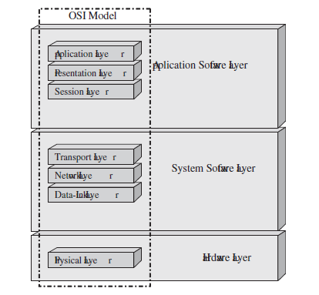
Open Systems Interconnection (OSI) Model
Universal networking model which demonstrate :
the dependencies between the internal networking components of an embedded system and the network’s architecture,
the distance between connected devices,
and the transmission medium connecting the devices,
All the required networking components in a device can be grouped together into the OSI model
Created in the early 1980s by the International Organization for Standardization (ISO).

Slide 18
(Cntd…)
Networking connection starts with data originating at the application layer of one device and flowing downward through all seven layers,
Each layer adds a new bit of information to the data being sent across the network.
Information, called the header is appended to the data at every layer (except for the physical and application layers) for peer layers in connected devices to process.
In other words, the data is wrapped with information for other devices to unwrap and process.
The data is then sent over the transmission medium to the physical layer of a connected device, and then up through the connected device’s layers.
These layers then process the data (that is, strip the headers, reformat, etc.) as the data flows upward.
The functionality and methodologies implemented at each layer based on the OSI model are also commonly referred to as networking protocols.

Slide 19
Thank You

Slide 20
Multiple Standards-Based Device Example: Digital Television (DTV)
Analog TVs process incoming analog signals of traditional TV video and audio content,
Digital TVs (DTVs) process both incoming analog and digital signals of TV video/audio content, as well as application data content that is embedded within the entire digital data stream.
Why Digital Television (DTV) ?
According to Forrester Research, average consumer spends seven (7) hours a day watching TV, and TV is in 99% of U.S. homes.
The type of application data embedded is dependent on the capabilities of the DTV receiver itself.
Depending on the type of receiver, DTVs can implement general-purpose, market-specific, and/or application-specific standards all into one DTV/set-top box (STB) system architecture design.

Slide 21
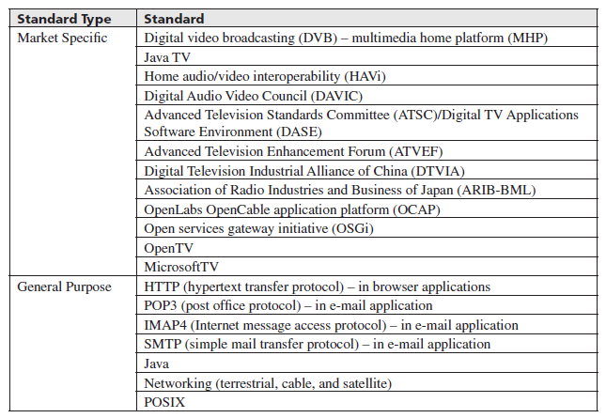
Examples of DTV standards

Slide 22
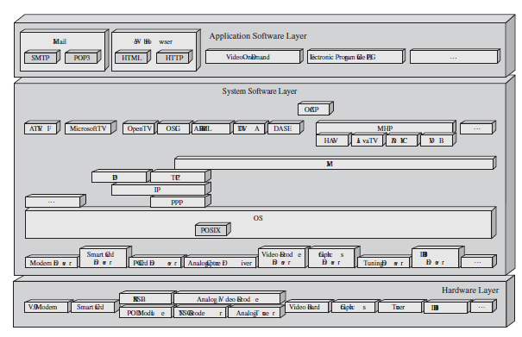
DTV standards in the Embedded Systems Model

